Slide 1
> glasgowrpg

Slide 2
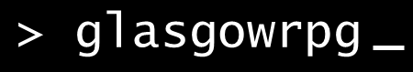
Overview
Text based rpg
Providing a story with multiple branches and outcomes
Based in/around student life.

Slide 3
Specification
Short story with multiple branches/outcomes
Tracked user state.
User accounts.
State stored with accounts.
Able to resume game.
Track/show decisions made by userbase.

Slide 4

System Architecture
Client
Middleware
Database
User

Slide 5
Walkthrough:
Site Map
Home Page(index)
Play
Help
Stats (hivemind)
Create Account
myAccount
Hall of fame/shame
Userbase Stats

Slide 6
Site URLs
/home
/play
/help
/hivemind
/hivemind/fame
/hivemind/consensus
/createAccount
/myAccount

